Slide 1
Sprint Planning
01/10/18

Slide 2
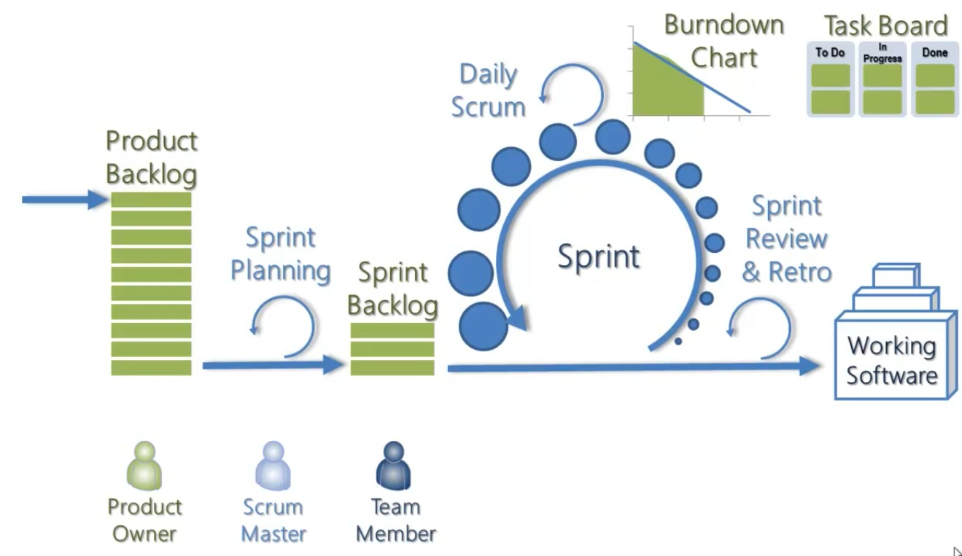
What is Agile and what are SCRUM ceremonies?
Agile is a group of development methodologies based on iterative development
Requirements and solutions evolve through collaboration between self-organizing cross-functional teams.
Encourages teamwork, self-organization and accountability
The Agile Manifesto states that:
Individuals and interactions over processes and tools
Working software over comprehensive documentation
Customer collaboration over contract negotiation
Responding to change over following a plan

Slide 3
Features for development
IC Blockchain
G/L account validation
<€2k exception
MCO admin workaround for exceptions (2 and 23)
WHT exception completion
AR Request preview page

Slide 4
Sprint Goal
IC Blockchain
GL account will be validated against master data when submitting IC form
Exceptions:
WHT completion (x2), MCO admin (5 and 25), <€2k
Request preview page
Input file for RPA to read
FCCR development
Infrastructure
Complete Dev Environment setup
SharePoint access and API calling complete
RPA
Credentials for robots (to be completed)
PDD and SDD review with UL (IC)
SDDs for FCCR reviewed with business
Confirm master data template for IC
Exceptions design for IC incorporated to SDD
SDD completion – AR and AP Posting IC
FCCR PDDs
Change Mgt
Next review with IC Aditya
Walk through planned with IC stakeholders including Demo
Review of approach with FCCR stakeholders

Slide 5
Actions / Priorities

